Slide 1

GLOBAL AND DOMESTIC AVIATION DATA INSIGHTS
AUTHORED BY: AFIFA SIDDIQUE
https://github.com/AfifaSiddiquee afeefaasiddiqueee98@gmail.com
AUG - 2024

Slide 2

DATASET OVERVIEW :
The dataset “Airport.csv” contains detailed information about airports from around the world.
Key attributes are:
Airport_ID: Specific code for airport given by OpenFlights
Name: Name of the Airport
City: City where the airport is located
Country: Country where the airport is located
IATA: Specific code given by IATA(3 letters)
ICAO: Specific code given by ICAO(4 letters)
Latitude: Geographical Information in 6 digits
Longitude: Geographical Information in 6 digits
Altitude: In feet
Timezone: Hours offset from UTC
DST: Daylight savings time
TZ: Timezone region

Slide 3
DASHBOARD
LET’S DIVE INTO DATA VISUALIZATIONS POWERED BY POWER BI.

Slide 4
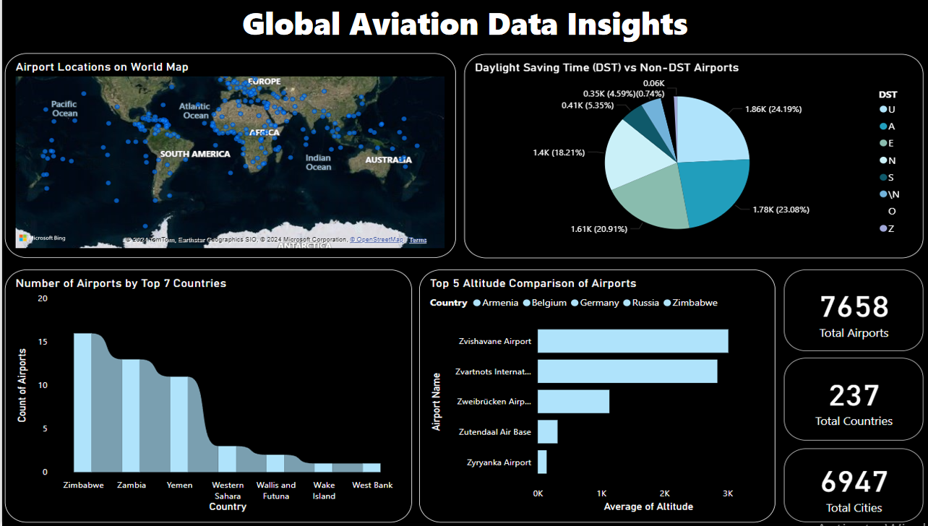

Slide 5
ANALYSIS FOCUS :
Global Distribution: Map airport locations to identify global patterns and major hubs.
Top 7 Countries: Assess the number of airports in the top 7 countries.
DST Comparison: Compare airport distribution with and without Daylight Saving Time.
Altitude Comparison: Evaluate the altitudes of the top 5 highest airports.
Overall Statistics: Summarize total airports, countries, and cities.

Slide 6
DATASET OVERVIEW :
The dataset “US_Airport.csv” focuses on airports and flight traffic within the United States.
Key attributes are:
Origin_airport: Three letter airport code of the origin airport.
Destination_airport: Three letter airport code of the destination airport.
Origin_city: Origin city name.
Destination_city: Destination city name.
Passengers: Number of passengers transported from origin to destination.
Seats: Number of seats available on flights from origin to destination.
Flights: Number of flights between origin and destination in that month.
Distance: Distance (to nearest mile) flown between origin and destination.
Fly_date: The date (yyyymm) of flight.
Origin_population: Origin city's population as reported by US Census.
Destination_population: Destination city's population as reported by US Census.

Slide 7
DASHBOARD
LET’S DIVE INTO DATA VISUALIZATIONS POWERED BY POWER BI.

Slide 8
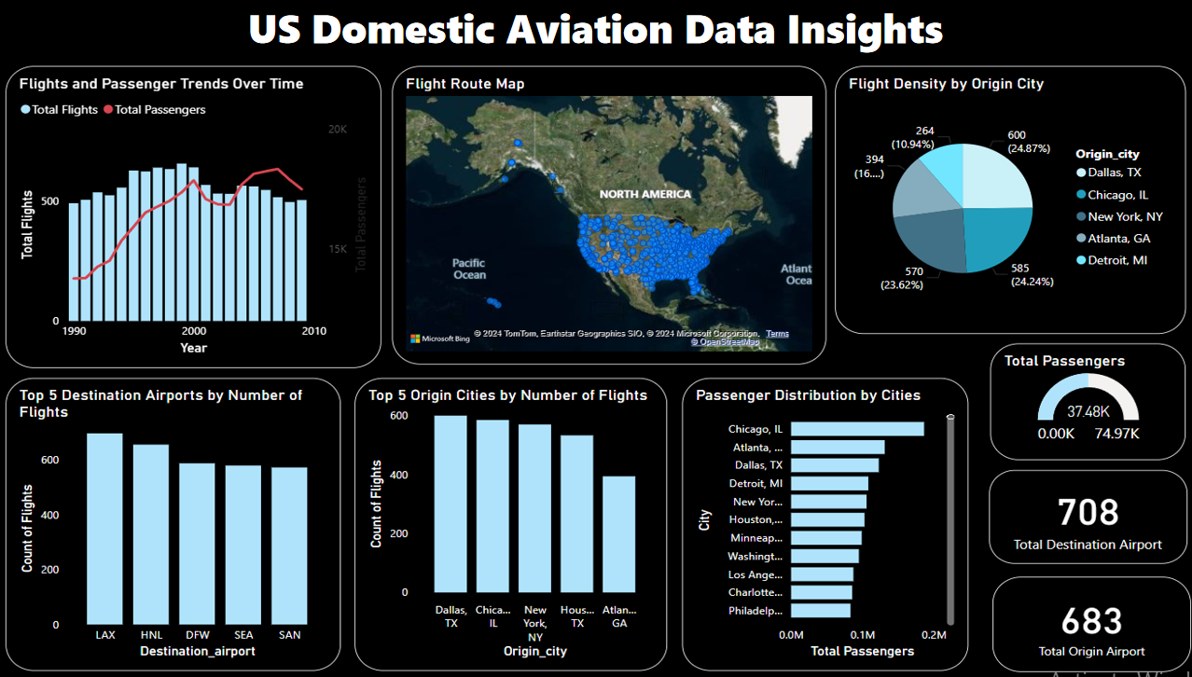

Slide 9
ANALYSIS FOCUS :
Trends Over Time: Track changes in flight and passenger numbers monthly.
Route Mapping: Visualize flight routes between origin and destination airports.
Flight Density: Analyze flight density by origin city.
Top Locations: Identify the top 5 destination airports and origin cities by flight count.
Passenger Distribution: Assess passenger distribution relative to flights.
Overall Metrics: Summarize total passengers, origin airports, and destination airports.

Slide 10
THANK
YOU
www.linkedin.com/in/afifa-siddiquii

